Slide 1


CMO Taskforce for the improvement of services for victims of rape and sexual assault
Children & Young People
Online Roadshow
November 2020

Slide 2


Introduction from Dr Gregor Smith
Chief Medical Officer
CYP Services
Online Roadshow
November 2020

Slide 3
Welcome &
Introductions
Dr Eddie Doyle
& Lucy Dexter

Slide 4

CMO Taskforce Overview
Legislation
Quality Improvement
Self-Referral
CMO Taskforce
Clinical Pathways
Delivery and Performance
Workforce and Training

Slide 5
Legislation Subgroup
Forensic Medical Services (Victims of Sexual Offences) (Scotland) Bill to Parliament in November 2019
  provide a clear statutory duty for health boards to provide forensic medical services for victims of sexual crime
  Stage 1
  Stage 2
  Stage 3

Slide 6
Self-Referral Subgroup
  Development of the national protocol
  National awareness raising campaign for the self-referral service
  Options for a website and accessing services via telephony, as well as how information can be made available in accessible formats.
  Retention period recommendation

Slide 7
Delivery and Performance
  Forensic medical examinations for victims of sexual crime in an appropriate healthcare setting
  Sexual Assault Response Coordination Services (SARCS)
  DNA Decontamination Protocol
  Colposcope for forensic medical examination

Slide 8
Workforce and Training
  FME training
  Develop the capacity of the workforce through the recruitment of nurse coordinators
  Test of Change to develop the role of nurse sexual offence examiners in Scotland
  Postgraduate Qualification course in Advanced Forensic Practice

Slide 9
Clinical Pathways
  Development of the Adult Clinical Pathway
  Development of the CYP Clinical Pathway via the Children and Young People Expert Group
  National standardised form for forensic medical examinations
  Forensic Medical Examination leaflet

Slide 10
Quality Improvement
  Oversight of the HIS Standards and Indicators
  Development of the national data sets
  Leading the development of the FMS National IT System

Slide 11
Standards &
Indicators
Fiona Wardell &
Rachel Hewitt

Slide 12


Standards and Indicators
Healthcare and forensic medical services for people who have experienced rape, sexual assault or child sexual abuse
Supporting better quality health and social care for everyone in Scotland

Slide 13


Slide 14
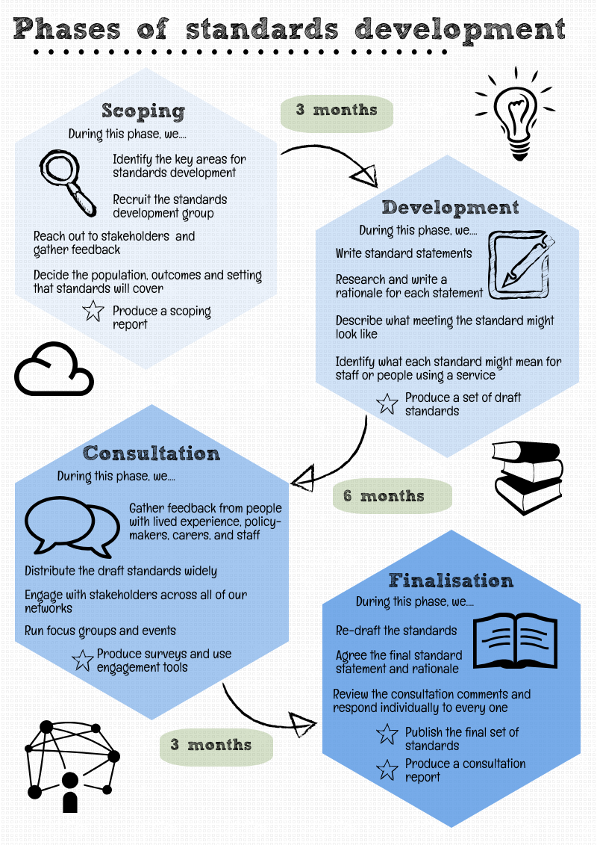
HIS Standards & Indicators
Standards
Provide statement of expected level of service, demonstrating delivery of person-centre, safe and effective healthcare
Promote understanding, compassion and improvement in care
Support national consistency and/or local improvement
Indicators
Measure the level of service performance that people received within a given reporting period
Measure the implementation of national standards
Allow for the identification of areas for improvement

Slide 15
HIS standards (2017)
Standard 1: Each NHS board demonstrates the leadership and commitment required for a co-ordinated response to meet the needs of people who have experienced rape, sexual assault or child sexual abuse, including immediate clinical needs assessment, forensic examinations and aftercare.
Standard 2: Each NHS board ensures that people who have experienced rape, sexual assault or child sexual abuse receive person-centred and trauma-informed care.
Standard 3: Each NHS board ensures that the facilities and equipment for forensic examinations are appropriate, safe and effectively managed.
Standard 4: Each NHS board ensures that staff have the knowledge, skills and competency to deliver healthcare and forensic medical services for people who have experienced rape, sexual assault or child sexual abuse.
Standard 5: Each NHS board ensures that forensic examinations of people who have experienced rape, sexual assault or child sexual abuse are recorded using consistent documentation and data collection.

Slide 16
Developing and piloting indicators
Development of the interim indicators
Revision of the interim indicators
Identification of standards to be measured nationally
Re-formation of the development group
National consultation
National consultation
Formation of the indicators development group
Publication of interim indicators
Piloting indicators and datasets
Publication of final indicators

Slide 17
HIS final indicators (2020)
Indicator 1: Sex of sexual offences examiner
Indicator 2: Timing of forensic medical examination
Indicator 3: Examination support
Indicator 4: Psychosocial risk assessment
Indicator 5: Sexual health
Indicator 6: Examination setting
Indicator 7: Decontamination of facilities
Indicator 8: Use of colposcopes
Indicator 9: National forensic documentation

Slide 18
Keep in touch
Twitter: @online_his
Email: hcis.standardsandindicators@nhs.scot
Web: healthcareimprovementscotland.org
Blog: blog.healthcareimprovementscotland.org

Slide 19
Overview of the Children and Young People Clinical Pathway
Marianne Cochrane; Stephanie Govenden; Sarah Hill; Charlotte Kirk

Slide 20
Clinical pathway for healthcare professionals to support children and young people who may have experienced child sexual abuse

Slide 21
How the pathway was developed
Under the remit of the CMO Taskforce, a Clinical Pathways Subgroup was established to develop national clinical pathways for both adults and for children & young people (CYP).
The CYP Pathway was developed by a wide range of multi-agency professionals
    Child Protection Managed Clinical Network (MCN) managers
    Paediatricians
    Police Scotland
    Third sector organisations
    Members of the Scottish Government child protection team

Slide 22
Purpose of the Guidance
Guidance for health professionals but can be used as a reference for other agencies & 3rd sector
Aims to ensure a consistent approach across Scotland to the provision of healthcare and forensic medical examination services for children and young people who may have experienced sexual abuse

Slide 23
Aims of the Pathway
To outline the healthcare response when a child or young person has made a disclosure or when there is concern that sexual abuse has occurred

Slide 24
Aims of the Pathway
Section 4
Healthcare services should
    Work in partnership with other agencies
    Keep the best interests of the child at the centre
    Provide appropriate and timely access to trauma informed holistic healthcare, emotional, mental and social support
    Focus on reduction of further harm and promotion of recovery
    Ensure that the examination meets the required forensic standards to support any future criminal justice process

Slide 25
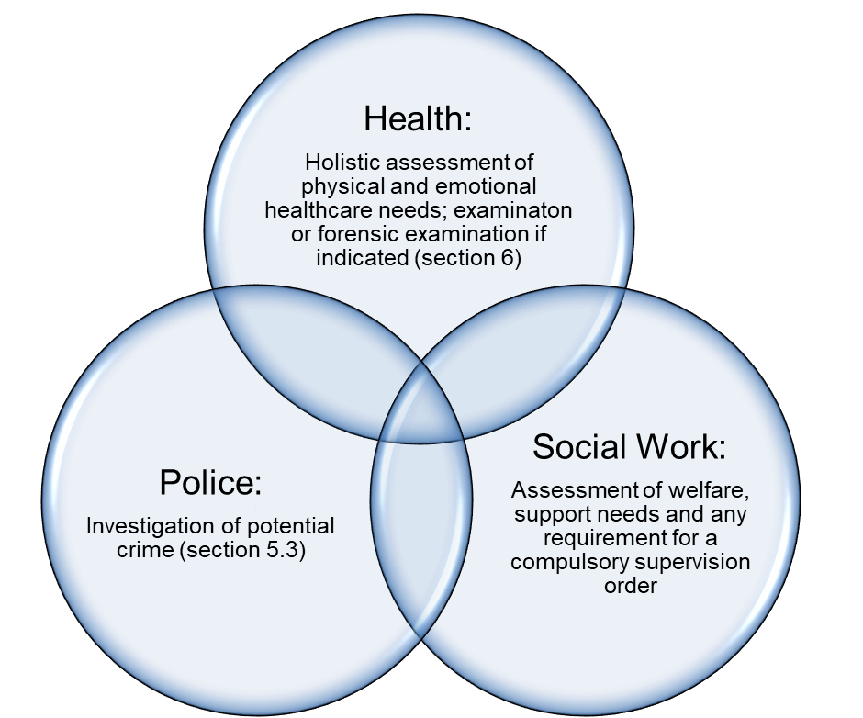
Pathway Overview
Disclosure by child / young person, suspicion of abuse by a professional or other adult, or indication from clinical presentation (section 5.1)
Interagency Referral Discussion (section 5.2) and Child Protection Procedures
Interagency Child Protection Procedures and safety plan where multi-agency support is put in place (section 5.4)

Slide 26
Pathway - Section 5
5:1 Disclosure/cause for concern
    Indicators that may cause concern
5:2 IRD
    Information sharing
    Decisions re CP process; JII; Medical examination
5:3 Police & SW Joint Investigative Interview
    Purpose of JI
5:4 Interagency CP procedures and Safety Planning
    Interagency guidance available in all local authorities
    Interagency collaboration re safety plan

Slide 27
Pathway - Section 6
6:1
    Outlines purpose of examination
6:2
    Preparation – information which should be available prior to examination
6:3
    Consent

Slide 28
Pathway -Section 6
6:4
    Timing of the examination
    Agreed between paediatrician and forensic practitioner
    Input from other agencies/child/family
6:5
    Photographic/Video evidence
    Data control
6:6
    Documentation
    Use of new CYP proforma

Slide 29
CYP Pro-Forma
(including guidance)
and Q&A
Marianne Cochrane; Stephanie Govenden; Sarah Hill; Charlotte Kirk

Slide 30

Updated National Child Protection Proforma

Slide 31
Introduction
3 MCNs collaborated to design and agree a nationally acceptable child protection proforma
Introduces an agreed standard for consent, history taking and documentation for all child protection concerns
Supports data collection and national comparisons of regions

Slide 32
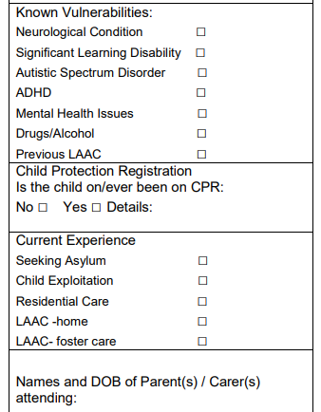
FRONT PAGE: VULNERABILITIES
Complete if known
Includes diagnosed conditions, not suspected
You do not have to ask specifically about all these
Seeking asylum or being looked after, or accommodated is a matter of record. SW will have the details.
Being a victim of exploitation can be sexual or criminal and may or may not be previously known to services for this.

Slide 33
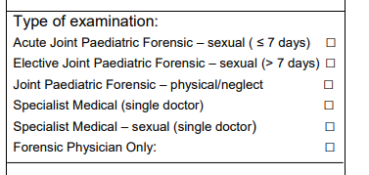
OUT OF HOURS = Outside of 9am-5pm Monday to Friday on normal working days
2 options for child sexual abuse examinations. If 2 paediatricians carrying out historic (>7 days) CSA medical = elective joint paediatric forensic medical.
Specialist medical single doctor = one paediatrician seeing child for physical abuse.

Slide 34
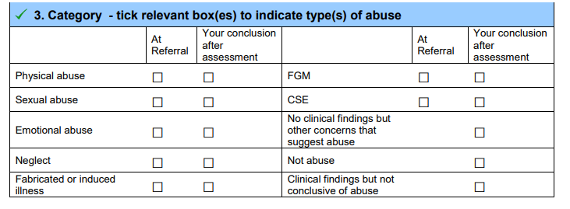
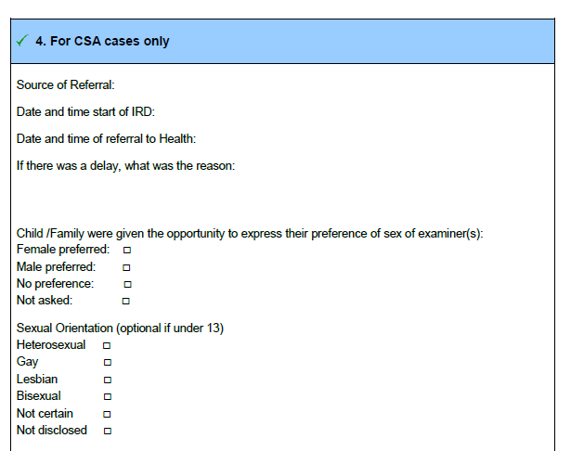

Slide 35
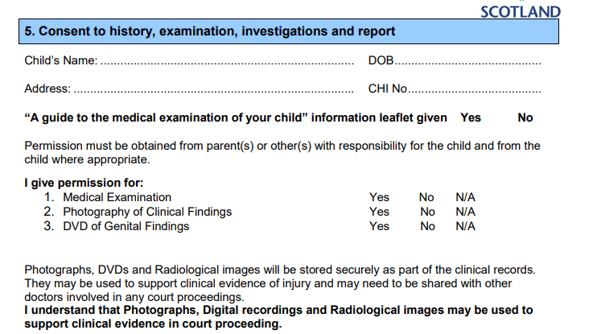
Consent: CHANGE

Slide 36
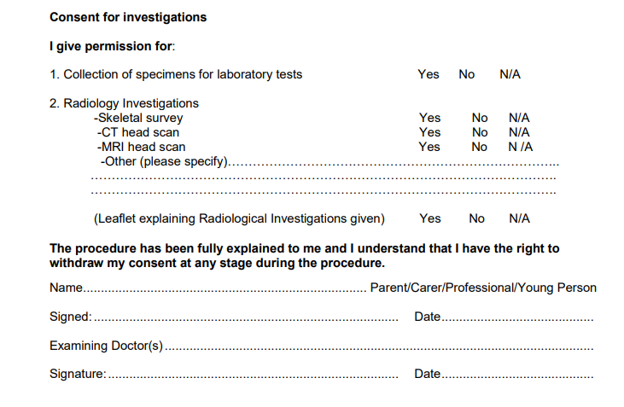
Consent for Investigations: p4

Slide 37
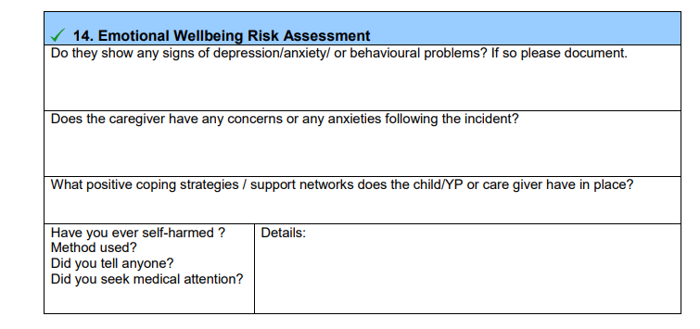
Emotional Wellbeing Assessment: CHANGE
Especially for CSA but can be used for any/ all child protection cases. This supports identifying need for onward referral.

Slide 38
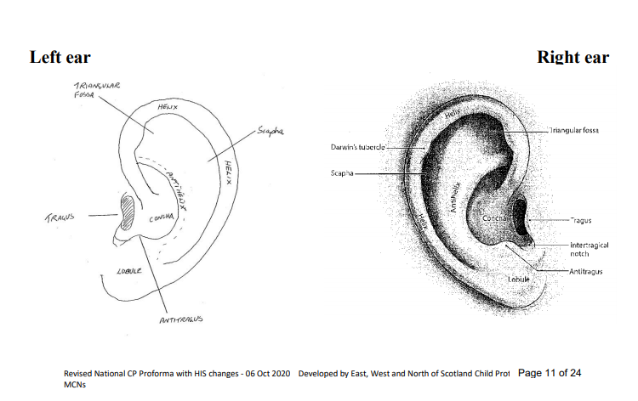
Body charts: CHANGE

Slide 39
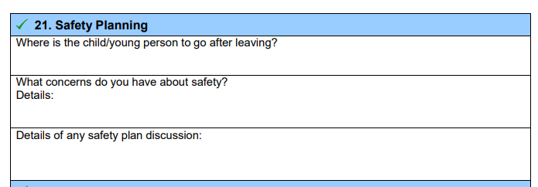
Safety Planning: CHANGE

Slide 40
Conclusions
Redesigned to support both forensic examiners and paediatricians
Guidance notes also have further details
Might seem bulky if doing straightforward NAI – but in child protection things are rarely straightforward and it helps to consider trauma, safety and need for further support in all cases

Slide 41

Thank you
Any questions?

Slide 42


Young People’s leaflet
isla.barton2@nhs.scot

Slide 43

Comfort Break
10 minutes

Slide 44
FMS IT System update
Susie Donaldson, Riomed

Slide 45











Software by
SAFE EFFICIENT QUALITY
WORLD CLASS ELECTRONIC HEALTHCARE SOLUTION

Slide 46


RioMed and Cellma
  Who we are
    International company delivering bespoke health information systems across the UK and Ireland
    Over 20+ years experience in healthcare
    Accreditations include:
      Information Security, Quality & Environmental Management ISO 27001/ ISO 9001/ ISO 14001
      NHS Accredited HSCN provider and registered with DSP Toolkit
      Cyber Essential Certified
  What do we do
    Improve the efficiency, quality and safety of patient care

Slide 47
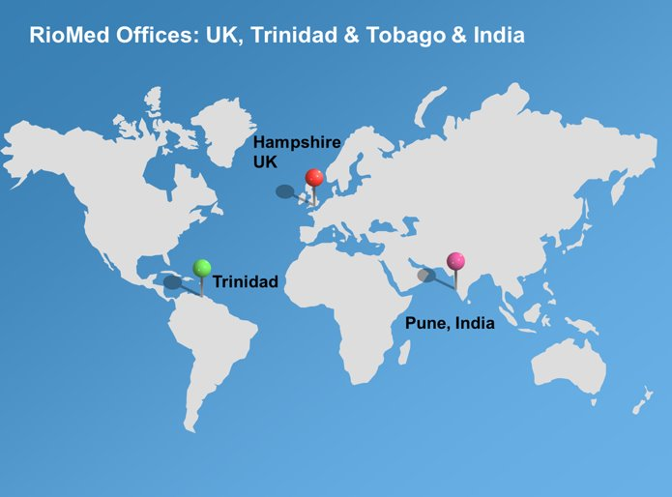
Where are we based – Global Support

Slide 48

Where are we working

Slide 49

Cellma Modules

Slide 50
Cellma Access
  Secure, web-based access
  Intuitive and user-friendly interface
  User & Patient Portals and Apps
  Supports secure Email, SMS Text & CHAT functionality
  Remote devices incl. tablets, mobiles devices
  Multiple browser support – Chrome, IE, Edge, Safari, Firefox
  Remote access to support community working

Slide 51
Our work with Forensic Medical Service
  1. The Collection of data and Information for Sexual Offences Against Adults Examination National Form and Child Protection Paediatric Examination
  2. The ability to interface with the colposcopy equipment in order to upload and store colposcopy still images and video as part of the patient record is included within this initial implementation.
  3. The solution must also have the potential to interface with 3rd party applications at a later date if required.

Slide 52
Cellma Benefits
  Standardisation of data collection process across Scotland across the clinical pathways
  Compliance with National Datasets for Adults and Children
  Standardisation of Quality of Care across Scotland
  Automatic generation of Quality Indicators across Scotland
  Embedded Document Management facility
  Automated reporting

Slide 53
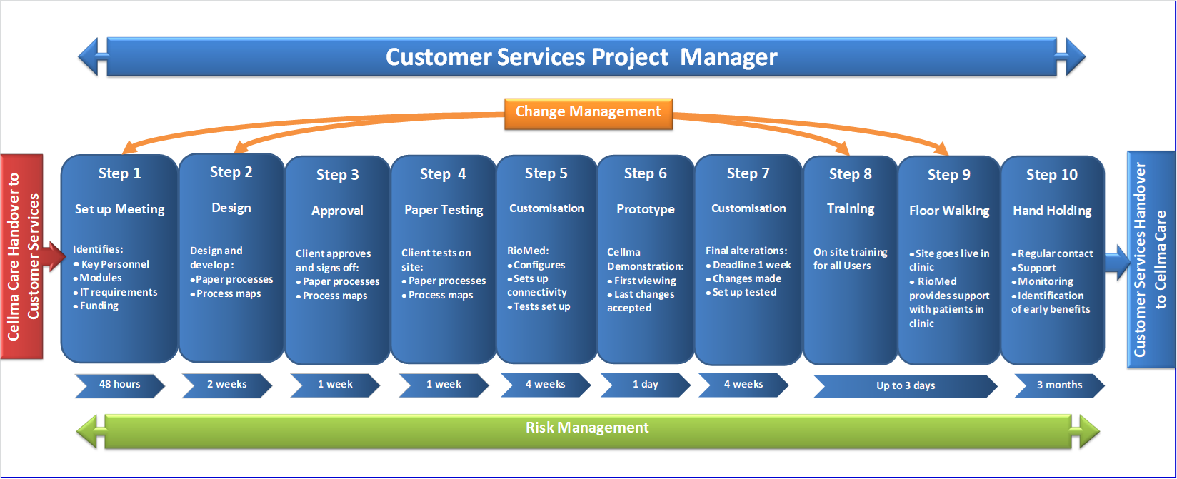
Implementation

Slide 54
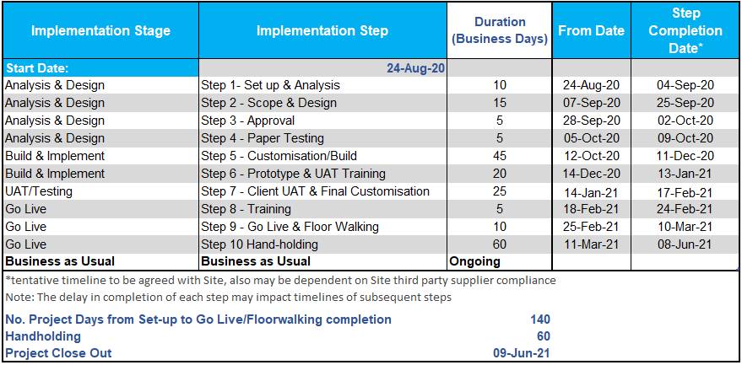
Tentative Project Timeline

Slide 55
Project Update
  Scope and high-level design agreed
  Completion of User Engagement Sessions
  Integration with Colposcopy Equipment gaining pace with DP Medical
  Assessments are in the build and customisation phase in Cellma
  Next Steps
    Share online assessments with user group for feedback
    Finalise process flow and workflows
  Consider later phase developments – long-term commitment to project

Slide 56
END

Slide 57
National Datasets
Elaine Parry &
Joanna Targosz

Slide 58
CYP Dataset Online Workshop
PHS RSA Team

Slide 59
Development of National Dataset for Children & Young People
Developed as part of the CMO Quality Improvement subgroup
Provides analytics and intelligence, including support of some of the Quality Performance Indicators (QPIs)
Consultation in Summer 2019, piloted in NHS Fife and NHS Ayrshire & Arran
Prior to development of national IT system, completion & submission will be via data recording template

Slide 60
National Dataset Benefits
Access to routine reports, e.g. MI, HIS indicators
Improved understanding of CYP needs & requirements
Information on workload, activity & demographics of CYP accessing services
Better delivery of service to meet those needs
Inform decisions about resources required
Consistent
Reliable
Comparable
Information
Service Users
Local Services
Perform audits
Improved provision of services for those affected by rape and sexual assault
Identify potential areas for improvement
Measure quality & adherence to standards
National & NHS Board Level
Support quality indicators established by HIS
Provision of publications & reports
Inform public health strategies
Data for research
National & local policy development and delivery

Slide 61
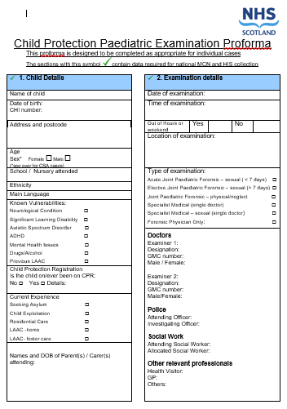



National Dataset Content
Child Details
e.g. DOB, CHI, ethnicity, vulnerabilities, child protection
Examination Details
e.g. exam location & time, IRD, nature of referral, examination outcome
Additional Details for CSA Cases
e.g. referral source & date, reason for delay
Paediatric Exam
e.g. onward referrals, colposcope use, Hep B prophylaxis
Information from
CPP Examination Proforma
Small Subset of Data
Management Information
National Reporting
Evidence for Indicators

Slide 62
Examples of National Dataset Use
Ind. 2
Timing of FM Examination
Ind. 1
Sex of SOE
Who performed the examination (roles/ designations/ sex)
Ind. 6
Examination Setting
How many JPFE were performed nationally & by NHS Board
HIS Indicators
Ind. 4
Assessed support needs & ongoing safety planning
Reasons for delayed examinations
National Reporting
Ind. 5
Access to Immediate Sexual Health Care
What was the type of examinations performed
Link to other health datasets
Data for more in-depth academic studies

Slide 63
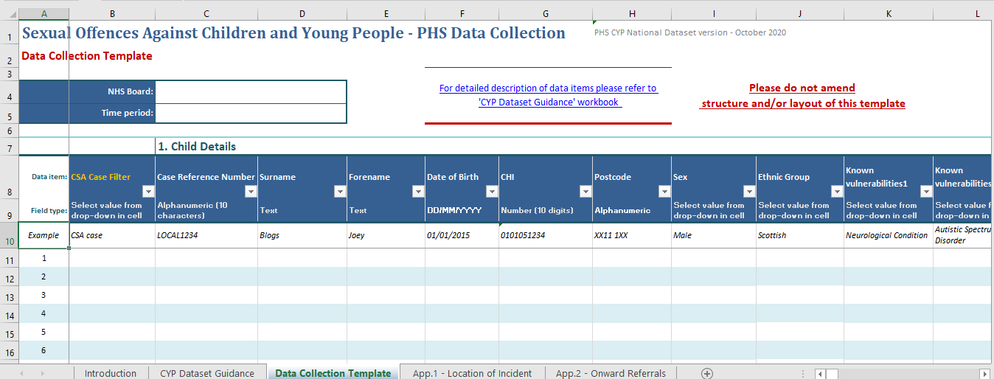
National Data Recording Template
Data items order matches the CPP Examination Proforma
Information Source
Excel spreadsheet

Slide 64
Template Structure
Introduction
Collection Template
→ basic info about content & purpose of the workbook
→ where data should be recorded
Onward Referrals
Dataset Guidance
Location of Incident
→ where data item is located in the template (i.e. which column)
→ what category it belongs to (.e.g. child details, examination details etc. )
→ data item name
→ field type (e.g. text, date, dropdown list)
→ data definition & if relevant, list of options on dropdowns
→ is validation built-in
→ corresponding item in the CPP Examination Proforma
→ details locations included in each category
Filters built in headers for quick search

Slide 65
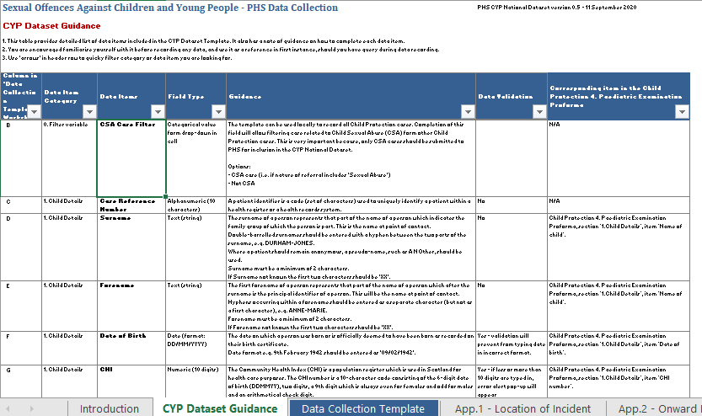
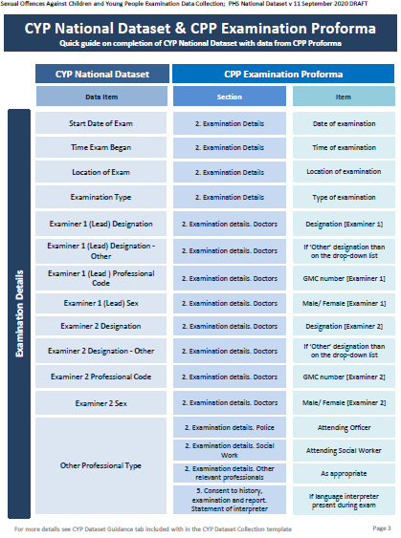
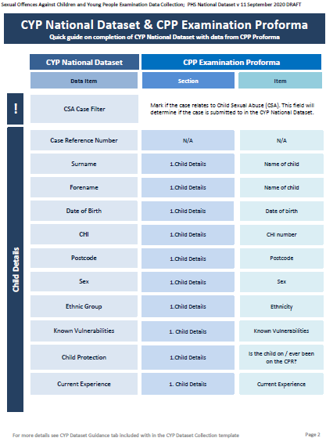
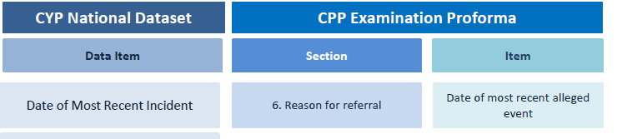
Finding Required Information
Dataset Guidance Tab
Collection Guide
E.g. the date of most recent incident can be found in section ‘6. Reason for referral’ in the CPP Examination Proforma, item ‘Date of most recent alleged event’.

Slide 66




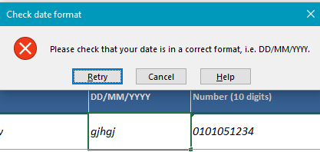
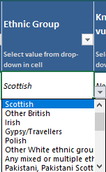
Recording Data
Data Entry Quality
is Important
1. Open Data Collection Template tab
2. Record Board name and Time Period
5. Save changes once record complete
3. Find corresponding item in the CPP Proforma
If applicable select data from dropdown list
4. Enter Value
→ Manual data entry
→ Validation built-in cells
→ Example included
Error message will appear if value entered in incorrect format
Scroll down if needed

Slide 67

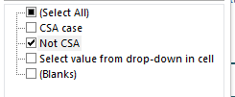
Preparing file with only CSA cases
If the template is used to record
all CPP examination cases,
a file with only CSA cases will have to created
PHS Information Governance approval only to collect CSA cases
1. Make copy of completed template – save file as ‘CSA cases only’
2. Open file and use ‘CSA Case Filter’.
Select ‘Non CSA’ records
4. Check that you have only CSA cases left in the file
3. Delete the ‘Non CSA’ rows
5. Save changes

Slide 68
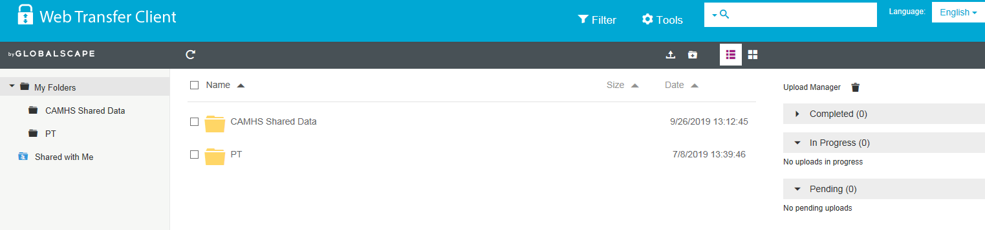

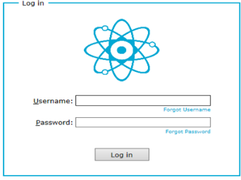

Submitting CSA Data
IG approvals & processes will be in place prior to receipt of any data
Secure file transfer portal
NHS Board uploads data to a dedicated folder only they can see
NHS Board individual login
PHS access the same folder
Proposed quarterly submissions
PHS save the data to our secure network folder
April 2021
July 2021
Exams undertaken in Dec 2020 – Mar 2021
Exams undertaken in Apr– Jun 2021

Slide 69
Please contact PHS
if you have any further questions or
would like to request additional training
Contact phs.rsa-data@phs.scot

Slide 70
Q&A Session
Please submit questions to Gillian.Warner@gov.scot

Slide 71
Session Close

