Slide 1
FGM; what you need to know
Clinical Evaluation Child Sexual Abuse
One Day Advanced Update
Stirling Court Hotel, Stirling
Friday 29th September 2017
Susan Kidd
Notes:
Introduce self, FGM work

Slide 2
Background
New subject to many in audience
By it’s very nature, potentially upsetting subject
  Violent and degrading act
  Normalisation within cultures
Likely to be people who are affected by FGM, directly or indirectly in many settings
Sources of information and support
Notes:
Media and literature attention

Slide 3
Aims
Address sensitively and respectfully
  Setting a tone for further learning and work
  Women/ families affected by FGM must be given
    Information, care, support
    Not pity
    Not stigmatisation

Slide 4
Aims
Focus on clinical staff, and FGM related
clinical knowledge, skills and responsibilities
Illustrative Case
Key messages
Some pathways and resources

Slide 5
Case
Paediatrician at interagency meeting with police and SW and community group in Edinburgh
“We believe this 2 yr old girl is at risk of FGM, as her mother has had FGM, and we do not know parent’s views or understanding of the subject”

Slide 6
What is FGM?

Slide 7
World Health Organisation
Female Genital Mutilation
“…all procedures that intentionally alter or cause injury to the female genital organs for non-medical reasons”

Slide 8
Case
“We think the mother has had type 3 FGM”

Slide 9
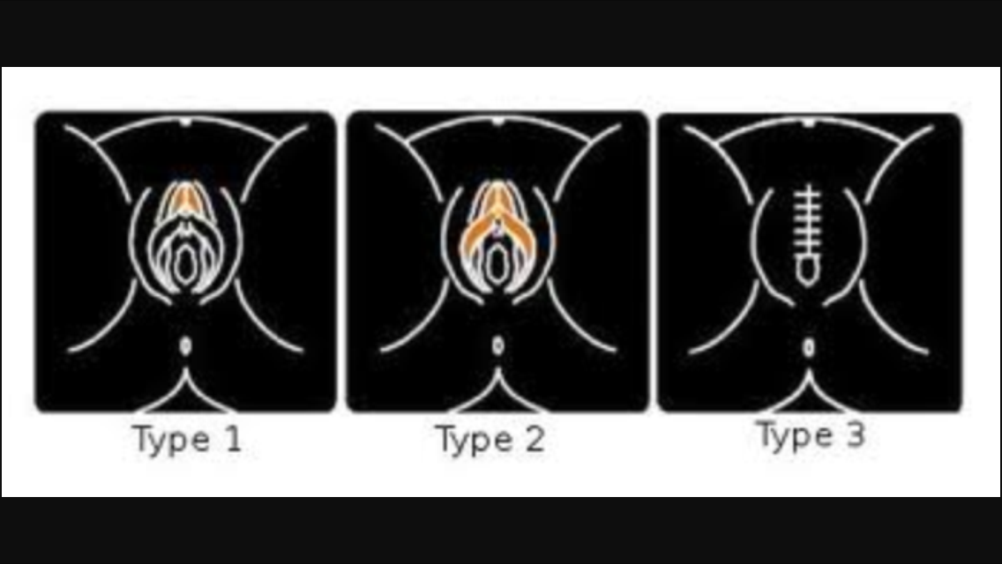

Slide 10
WHO 4 types
Type 1: Clitoridectomy: partial or total removal of the clitoris and, in very rare cases, only the prepuce
Type 2: Excision: partial or total removal of the clitoris and the labia minora, with or without excision of the labia
Type 3: Infibulation: narrowing of the vaginal opening through the creation of a covering seal. The seal is formed by cutting and repositioning the inner, or outer, labia, with or without removal of the clitoris.
Type 4: Other: all other harmful procedures to the female genitalia for non-medical purposes, e.g. pricking, piercing, incising, scraping and cauterizing the genital area.

Slide 11
Type; does it matter?
All types are harmful and treated the same way in terms of child protection and law
Symptoms may vary depending on type
All types are harmful physically and psychologically
It can be difficult to assign a type, even after specialist examination

Slide 12
Best practice is to describe what you can see, what you cannot seen, what looks normal, what does not.
  It may be impossible to categorise by WHO system
    Don’t panic!

Slide 13
A mother who has had FGM, is regarded as a significant risk indicator for her daughter(s)

Slide 14
Case
“The parents are from Somalia, and came to this country via Holland.”

Slide 15
Where is FGM carried out?

Slide 16
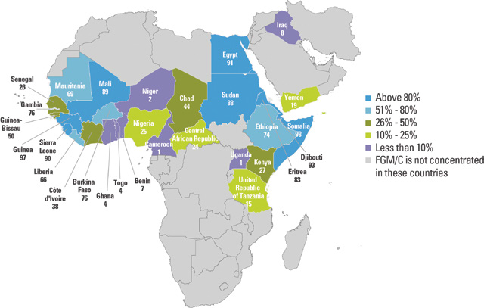

Slide 17
Highly variable
FGM has also been documented in communities including:
  Iraq
  Israel
  Oman
  the United Arab Emirates
  the Occupied Palestinian Territories
  India
  Indonesia
  Malaysia
  Pakistan

Slide 18
Ethnic group rather than nationality
  eg Nigeria
    2.7 % NE
    53.4 % SW
    Girls of Nigerian origin represent the largest single group of at risk girls in Scotland

Slide 19
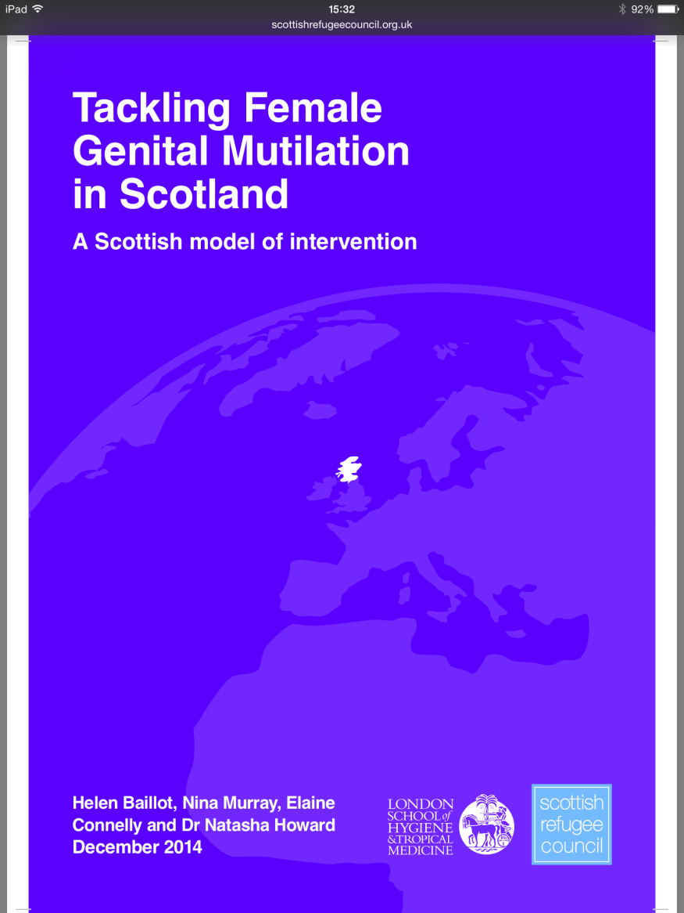
So how many at risk girls are there in Lothian?
We don’t know for sure....

Slide 20
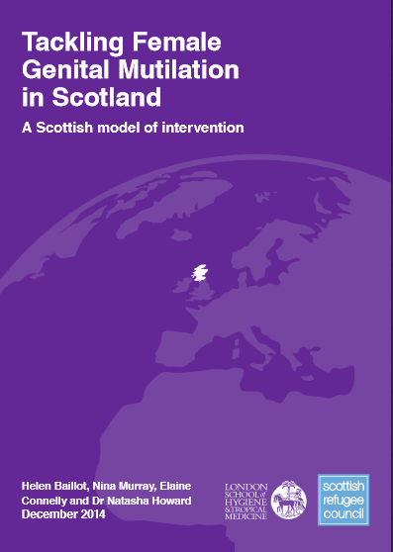
“……in 2012, 733 children were born in Scotland to mothers from an FGM-practicing country, of which, 363 were girls. ……………… we can approximate a minimum additional 700 children per year born into communities living in Scotland potentially affected by FGM.“
Tackling FGM in Scotland. A Scottish model of intervention. 2014. Page 14
Notes:
Information for participants:
Please note that this is based on nationality and it should not be assumed that all these mothers will have been subjected to FGM, nor that all these girls are at risk.

Slide 21
Scotland
The 2011 census records the following number of people from countries where FGM is traditionally practised:
  Glasgow City 8,861;
  Aberdeen City 4,246;
  Edinburgh City 3,587;
  and Dundee City 1,130.

Slide 22
Lothian?
Maternity; about 50 women per year who have experienced FGM
Community groups; 70 at risk girls all ages in last year
  Arbitrary; ‘window’/ tip of iceberg
Schools data; ?1000 school aged girls
Pre-school; ?200 + new to area

Slide 23
Constant change; for example
FGM is observed in Syria, particularly in its Kurdish, Shafi'i and minority Muslim groups.
‘WADI’ report; >80% of Kurdish women have had FGM, >30% of graduates.
Glasgow one of largest centres for refugees in UK, with constant flux to other areas of Scotland

Slide 24
Case
“the family have little English and are isolated”
More likely to hold traditional beliefs, such as FGM, and be unaware of health, media and campaigning information about FGM
  (But educated and affluent families still frequently affected by FGM)

Slide 25
Why is it carried out?
Most parents arranging to have FGM carried out on their daughters love them wholeheartedly, have their interests at heart and believe it is the best thing for them.
Today’s girls may be the first in hundreds of generations not to have FGM

Slide 26
Do you need to know why FGM is carried out?
NO
  Highly variable
  Purity/ marriage prospects/ right of passage
  Complex
  Ancient origins
  Emotive
  Control of sexuality and women’s bodies

Slide 27
What you DO need to know is
1. FGM is child abuse
2. FGM is against the law
3. All health care professionals have a responsibility to be aware and respond appropriately

Slide 28
Why is FGM considered child abuse?
“FGM is a violation of a child’s rights and is a child protection issue. It is considered to be a form of gender based violence against women and girls and is managed in accordance with existing child and adult protection structures, policies and procedures.”
...child protection is everybody’s job...

Slide 29
Acute clinical presentations of FGM
severe pain
emotional and psychological shock
  (exacerbated by having to reconcile being subjected to the trauma by loving parents, extended family and friends)
haemorrhage
wound infections, including tetanus and blood borne viruses (including HIV and Hepatitis B and C)
urinary retention
injury to adjacent tissues
fracture or dislocation as a result of restraint
damage to other organs
death.

Slide 30
Later presentations of FGM
chronic vaginal and pelvic infections
difficulties with menstruation
difficulties in passing urine and chronic urine infections
renal impairment and possible renal failure
damage to the reproductive system, including infertility
infibulation cysts, neuromas and keloid scar formation
obstetric fistula
complications in pregnancy and delay in the second stage of childbirth
pain during sex and lack of pleasurable sensation
psychological damage, including a number of mental health and psychosexual problems such as low libido, depression, anxiety and sexual dysfunction; flashbacks during pregnancy and childbirth; substance misuse and/or self-harm
increased risk of HIV and other sexually transmitted infections
death of mother and child during childbirth.

Slide 31
Case
“this child is only 2 years old, so we don’t need to worry about child abuse in the form of FGM, as it is usually when the child is about 10 that it is performed”

Slide 32
Age
There is huge variability in practice;

Slide 33
Traditional age changing due to migration, legal pressure and new patterns of family visiting/ interacting and being ‘opportunistic’.

Slide 34
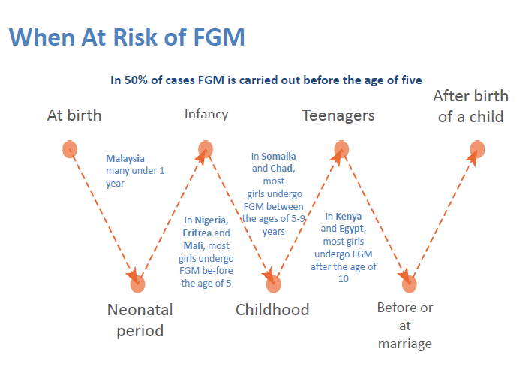

Slide 35
Risk is a ‘dynamic continuum’ and FGM
risk assessment and monitoring for a girl
is ‘an ongoing conversation for her whole
childhood’.

Slide 36

What does the law say?

Slide 37
The Law in Scotland
FGM has been unlawful in Scotland since 1985. The Female Genital Mutilation (Scotland) Act 2005 re-enacted the Prohibition of Female Circumcision Act 1985 and extended protection by making it a criminal offence to have FGM carried out either in Scotland or abroad by giving those offences extra-territorial powers. The Act also increased the penalty on conviction on indictment from 5 to 14 years’ imprisonment.

Slide 38
The Law in Scotland
The Scottish Government has worked collaboratively with the UK Government to close a loophole in the Prohibition of Female Genital Mutilation (Scotland) Act 2005. This will extend the reach of the extra-territorial offences in that Act to habitual (as well as permanent) UK residents. This strengthening of legislation is included in the Serious Crime Act 2015 which received Royal Assent on 03 March 2015 with the provisions for Scotland commencing on 03 May 2015.

Slide 39
England/ rest of UK
Mandatory reporting
Health and social care data base
FGM prevention order
BPSU; YES includes Scotland

Slide 40
What are my responsibilities as a health care professional?

Slide 41
All healthcare workers including all nurses, midwives and doctors have a duty of care to girls and women who are at risk of having FGM carried out, or who have already been affected by FGM. The Chief Nursing Officer and Chief Medical Officer for the Scottish Government have written to all healthcare professionals highlighting this
  obligation and the responsibility to understand and act in response to actual and potential FGM.
http://www.sehd.scot.nhs.uk/cmo/CMO(2014)19.pdf

Slide 42
A letter from the Chief Nursing Officer/Chief Medical Officer in Scotland was issued in July 2015 to inform health professionals (in Scotland) of the additional resources available to support the delivery of services to people who have had FGM or at risk of FGM. It also provides a reminder to be alert to young girls being taken out of Scotland to have FGM performed - CMO/CNO Letter 2015.

Slide 43
Case
No background info from SW or Police files
Discussed with HV and GP
No health documented previous risk assessment of discussion with family
Born out with region
HV keen to discuss with mother (alone) without SW initially, in supportive environment
Appropriate interpreter arranged and briefed

Slide 44
Discussions; guidance
“I see that your family is originally from Somalia. I understand that ‘Gudiniin’ or ‘cutting’ is practiced in some communities from Somalia. Is this something that affects your family?”
..........
‘Have you experienced ‘cutting’?

Slide 45
Discussion do’s and don’t’s
Discuss with MD and MA colleagues
  Make no assumptions
  Give the individual time to talk and be willing to listen
  Create an opportunity for the individual to disclose, seeing the individual on their own in private
  Be sensitive to the intimate nature of the subject
  Be sensitive to the fact that the individual may be loyal to their parents/family/wider community
  Be non-judgmental (pointing out the illegality and health risks of the practice, but not blaming the girl or woman)
  Get accurate information about the urgency of the situation if the individual is at risk of being subjected to the procedure
  Use simple language and ask straightforward questions
  Use terminology that the individual will understand e.g. the individual is unlikely to view the procedure as ‘abusive’; ask ‘have you been cut?’
  Avoid loaded or offensive terminology such as ‘mutilation’
  Use value-neutral terms understandable to the woman, such as ‘have you been closed?’, ‘were you circumcised?’
  Be direct as indirect questions can be confusing and may only serve to reveal any underlying embarrassment or discomfort that you or the woman may have
  Give the message that the individual can come back to you if they wish
  Give a clear explanation that FGM is illegal and that the law can be used to help the family avoid FGM if/when they have daughters
  Give a clear explanation of the health impacts of FGM with a view to encouraging the woman or girl to seek and accept medical assistance.

Slide 46
Case
Mother disclosed FGM type 3; referred to specialist clinic
Family ‘noncommittal’ when views explored
SW therefore joined HV for visit
Family disclosed that they planned trip to Somalia in summer;
  4 months long
  Rural; 40 miles from town
  Matriarchal family home

Slide 47
Case
Agreed by all agencies to be a ‘high risk’ scenario
Case ‘escalated’ to Child Protection investigation
Interagency Referral Discussion (IRD)
  Health, Police, SW all jointly involved in risk assessing

Slide 48
PROCEED TO IMMEDIATE CHILD PROTECTION REFERRAL (IRD)
Girl is known to come from a community affected by FGM (see map )
AND any of the following:
  Indication of imminent (within one month) trip to country where communities are known to be affected by FGM
  The family have expressed non-protective views
  Sibling has had FGM
  Child has had FGM
  Child discloses risk of FGM

Slide 49
Risk of FGM
Known
plans
for FGM
Largest Group
of at risk girls
No ‘risk factors’
known by agencies
Trip to country of origin
Non-protective views (parent or child)
(Mother has experienced FGM;
known in few cases)
Degree of cultural assimilation, including language
    (But remember that level of social status or education are not protective factors)
Family are from country of origin where FGM is practiced
Notes:
Slide shows increasing risk with different know risk factors.
However, most important point is that risk factors are not that reliable, and most agencies are not aware of them, leaving substantial number of most at risk girls unidentifiable.
Hence importance of public health/ population level work, and not alienating communities by child protection actions.

Slide 50
Risk of FGM
Known
plans
for FGM
IRD
Trip to country of origin
Threshold
Non-protective views (parent or child)
(Mother has experienced FGM;
known in few cases)
Degree of cultural assimilation, including language
    (But remember that level of social status or education are not protective factors)
Family are from country of origin where FGM is practiced
Notes:
It is not practical to have an IRD for every child in Lothian whose family have origins in a country with communities known to practice FGM.
Most of the time, we will not know if a mother has experienced FGM or not.
When it is known that a mother has experienced FGM, she is often very protective of her daughter with regard to this, which can be easily established in a consultation.
If this is not the case, then this is regarded as ‘non-protective views’ and takes to IRD threshold.

Slide 51
Risk of FGM
Known
plans
for FGM
IRD
No ‘risk factors’
known by agencies
Trip to country of origin
Threshold
Non-protective views (parent or child)
Maternity+/-SW
HV +/-SW for <5 yrs
School +/- SW >5 yrs
(Mother has experienced FGM;
known in few cases)
Degree of cultural assimilation, including language
    (But remember that level of social status or education are not protective factors)
Family are from country of origin where FGM is practiced
Notes:
For cases where discussions should take place (below IRD threshold) the groups that has no clear ‘way in’ by a professional equipped to discuss FGM is school aged girls.
This is a difficulty whether there is IRD or not; challenge of ‘cold calling’ parent on basis of country of origin. Probably SW.

Slide 52
Case
Detailed work with family by SW
Parents eventually felt to be informed and protective
Family tree drawn, indicating every female member of family for 4 generations had type 3 FGM
Scottish Government FGM statement given
Police + SW safety plan in place in case of coercion
Pre-visit holistic health check, including examination of genitalia
  Unmet health needs identified
  Parents felt empowered by documentation of normal exam

Slide 53
Case
Family travelled
Delayed return due to ill health
See in clinic by CCH on return
  No FGM; examination confirmed
  All had malaria; referred appropriately
  Other health referrals; ?TB
  Parents positive about and grateful for health and SW input; working collaboratively

Slide 54
Key points
Vulnerable population
Many unmet health needs
Mobile
‘Hard to reach’
Little English understood
Little contact with (health) services
Time consuming detailed work

Slide 55
FGM; clinical pitfalls
Normalisation of symptoms
  Take detailed systematic history of (GU) symptoms
Don’t infer from history the anatomical type
Remember BBV risk
Examination
  Be aware of limitations
  Avoid repeated examination
  Should be with colposcope (SCAN) in clinic
    Unless acute pain/ bleeding/ infection etc

Slide 56
Pitfalls; “not like other CP”
Single event
May happen abroad
Risk to associated girls and women
Associated honour based crime/ harmful traditional practices
Interpreter issues important

Slide 57
Case 2
15 yr old
Disclosed to school teacher FGM age 8
Phoned in as CP referral; IRD
Seen in CCH clinic at girl’s request
Disclosed CSA at clinic
FGM type1 + transection hymen
BBV screening negative
Referral ‘Meadows’ for trauma work .... ongoing
DVD reviewed with adult gynae consultant;
  potential for corrective procedure
Notes:
Susan

Slide 58
Medical Assessment of Children
1. Acute symptoms:
If a child or woman presents with acute symptoms, she should be examined in the usual way by Accident and Emergency Department or GP professionals, for assessment of need for urgent intervention.

Slide 59
2. Non-acute situation:
If there is a non-acute indication for examination, then the situation needs to be weighed up carefully, with an experienced paediatrician involved with decision making. This should be done if it is in the best interests of the child, for example if she has symptoms. It should be done by an experienced paediatrician, in a planned and supportive way, usually in the ‘SCAN’ clinic by the child protection team. Not all girls who have undergone FGM need to be examined.

Slide 60
3. Unnecessary repeated examinations
by inexperienced staff should be avoided by careful consideration, discussion and planning.

Slide 61
4. Women with complications of FGM
may be seen in the specialist service for women who have had FGM - referral via SCI Gateway F.A.O. Consultant with Special Interest in FGM.

Slide 62
5. Blood Borne Viruses
Because FGM is usually carried out in a non-clinical setting, using instruments that have not been sterilised, and which may have been used repeatedly for FGM procedures on other girls, the transmission of Hepatitis B, C and HIV is an appreciable risk. Even if there is lack of clarity about whether to carry out an examination, there should be consideration of a holistic and supportive medical assessment to include blood borne virus screening, exploration of symptoms, and the offer of a supportive examination and evaluation if indicated.

Slide 63
6. Forensic evidence:
If you believe that a criminal offence has been committed and FGM carried out, there may be a need for corroborating evidence in the form of a joint paediatric forensic examination. This must be discussed with child protection paediatricians and police, as part of an Inter-agency Referral Discussion (IRD)

Slide 64
7. A holistic assessment
which explores any other medical, support and protection needs of the girl or young woman is offered and appropriate referrals, including mental health, should be made as necessary.

Slide 65
8. Visible evidence of FGM
particularly type 4, may be difficult to discern on ‘standard’ or ‘naked eye’ inspection, so specialist examination should always be discussed with the child protection team where there is a concern that FGM has been

Slide 66
Our learning...
Remember not to ‘gloss over’ detailed inspection of the clitoris and prepuce
Remember to palpate any area where you think there has been removal of tissue
Remember to liaise with gyn colleagues who know about therapeutic intervention .....

Slide 67
Interagency Risk Assessment Document (circulated)
“Risk Assessment document" was drafted in order to pull together an ‘aid memoir’ cum checklist
It also represents a checklist of key information for FGM risk assessment.
evaluated during the ‘tests of change’
  (Early Years Collaborative)
response to the request for detailed and directive guidance by those professionals working within the agencies and expressed via their representatives at the interagency working group.
Covers key police, health and SW info; interagency
Mapped to DOH risk framework

Slide 68
Flow charts (circulated)
clear pathways in place for girls who are at imminent or ‘high’ risk of FGM (IRD)
clear pathways for women who may have been affected by FGM, who
  present to sexual health and gynaecology services
  present to maternity services
<5yr girls who are from families from communities who may have been affected by FGM to be addressed by HVs +/- SW
School aged girls risks to be assessed jointly by education +/- SW

Slide 69
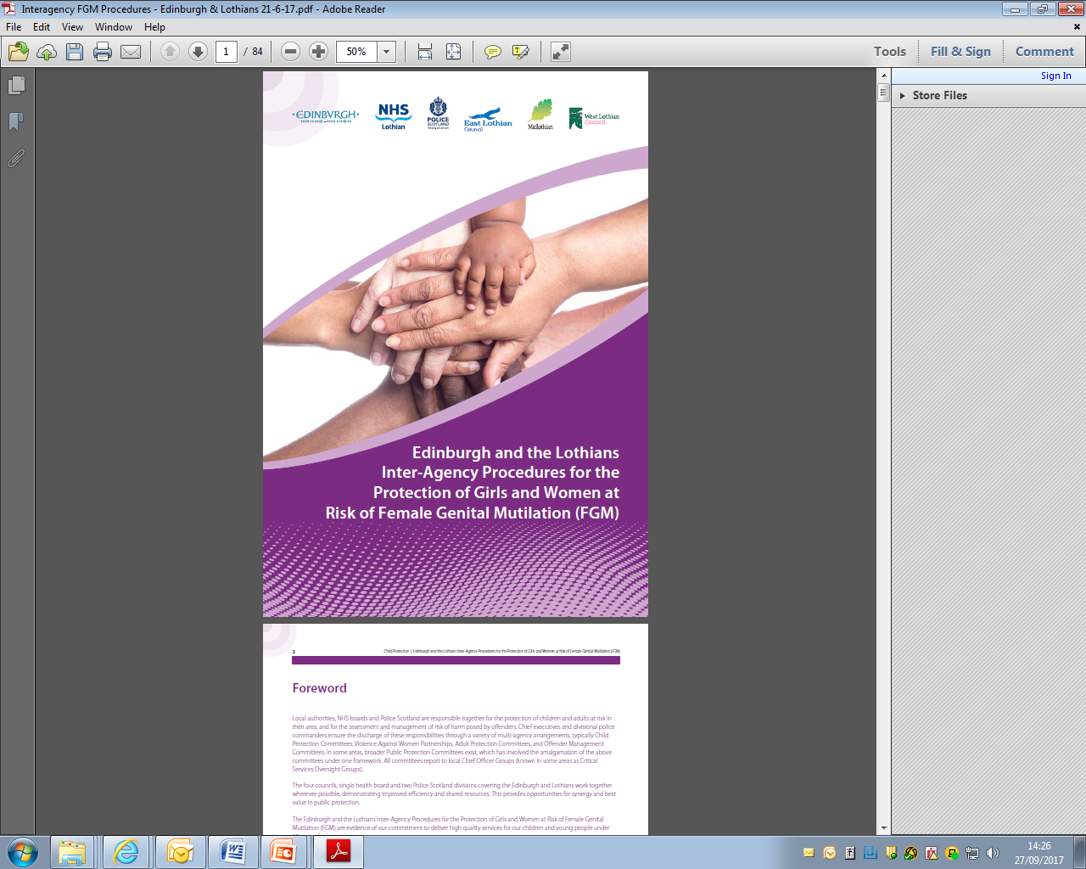

Slide 70
The future is bright; ☺
Have opportunity to make real difference to lives
Robust legal and political backing
Scotland/Lothian significant but ‘manageable’ numbers of at risk girls

Slide 71
Re-cap; what you need to know;
1. FGM is child abuse
2. FGM is against the law
3. All health care professionals have a responsibility to be aware of FGM risk and respond appropriately
4. Carefully planned, supportive detailed exam with DVD recording, then MD liaison is essential

